Slide 1

New River Remedies
Prescribers Redux

Slide 2


Tools & Workflow
Connected PostgreSQL to Python using SQLAlchemy inside Jupyter Notebooks.
Queried data directly from multiple tables (prescription, drug, overdose_deaths, population).
Used pandas for cleaning, joining, and reshaping large datasets.
Applied Python visualization libraries (matplotlib, seaborn) to reveal trends.
Translated raw SQL results into clear tables, metrics, and graphs.
Combined technical tools with analytical reasoning to answer:
How spending on opioids relates to overdose deaths.
County-level differences (Davidson, Shelby, etc.).
Links between unemployment and opioid use.

Slide 3
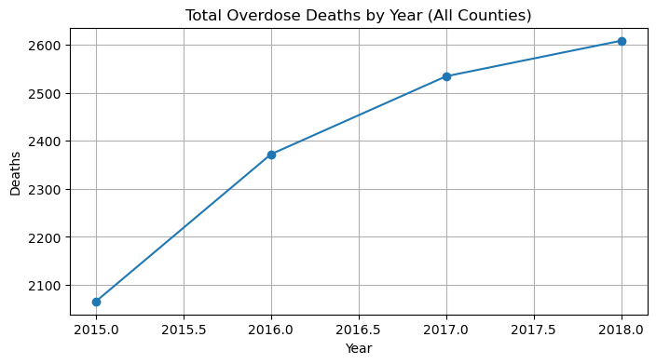
Trends in Total Overdose Deaths Over Time

Slide 4
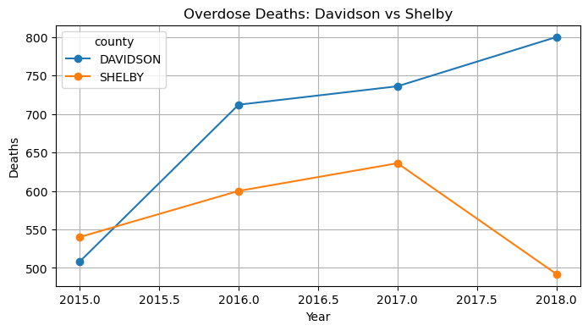
Trends in Overdose Deaths: Davidson vs. Shelby Counties

Slide 5
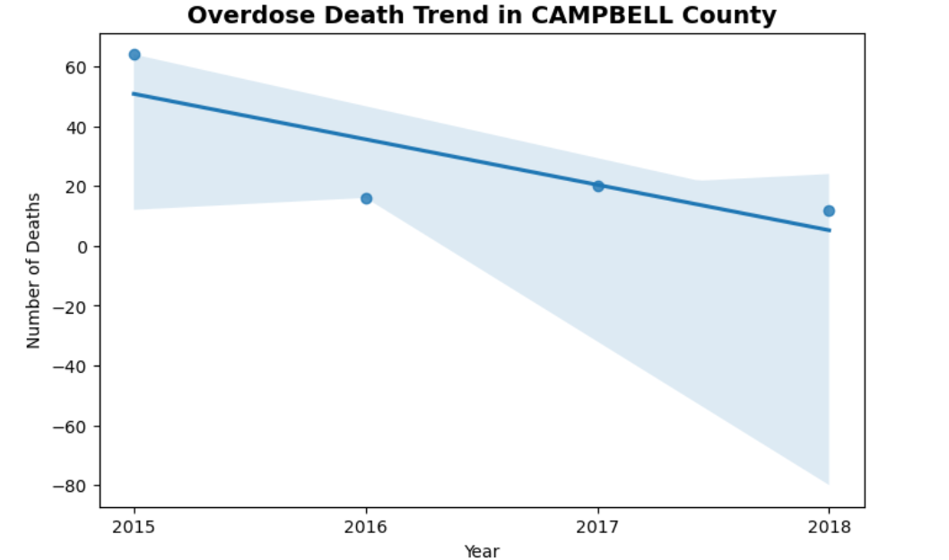
The 3 Most Downward Trending Counties

Slide 6
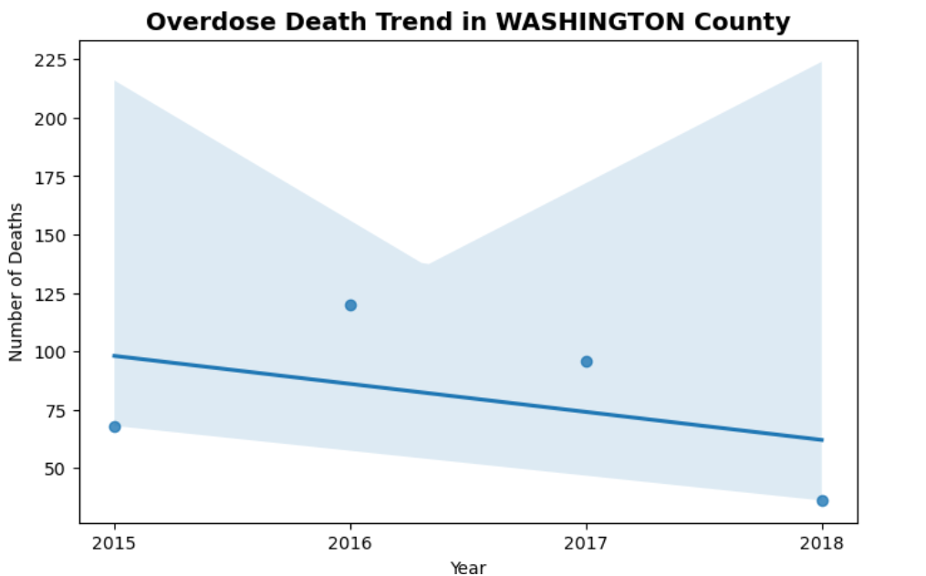

Slide 7
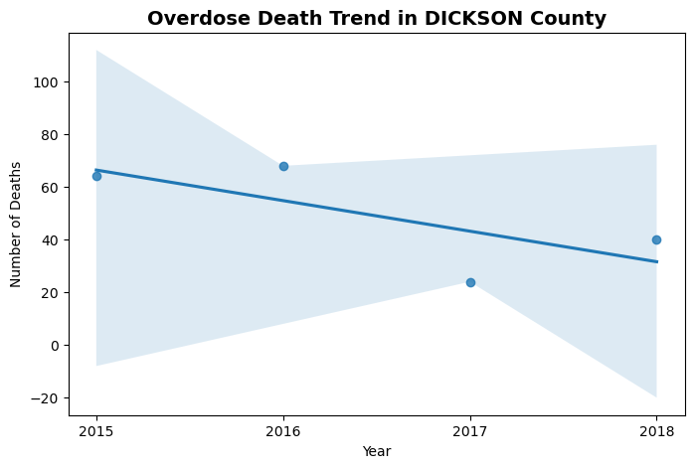

Slide 8
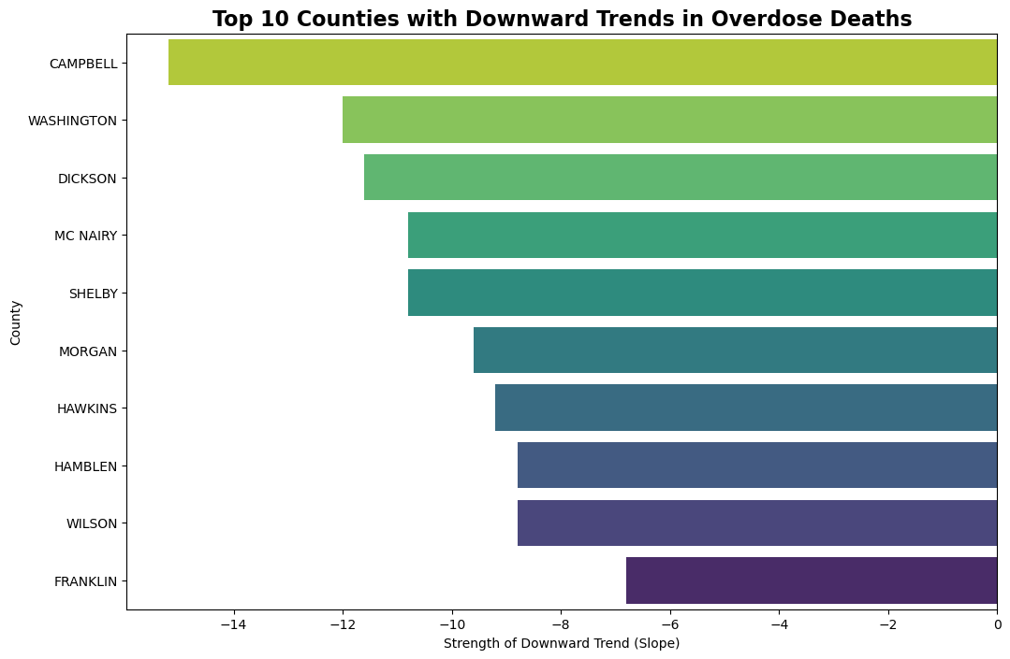

Slide 9
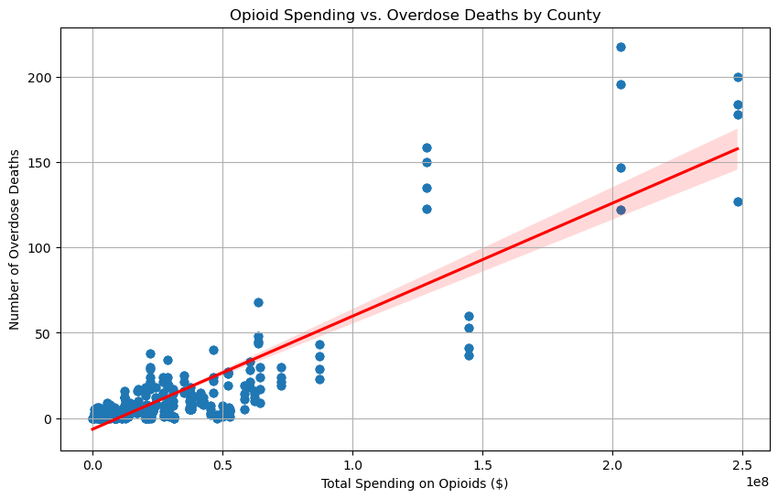
Opioid Spending and Overdose Deaths: What’s the Connection?

Slide 10
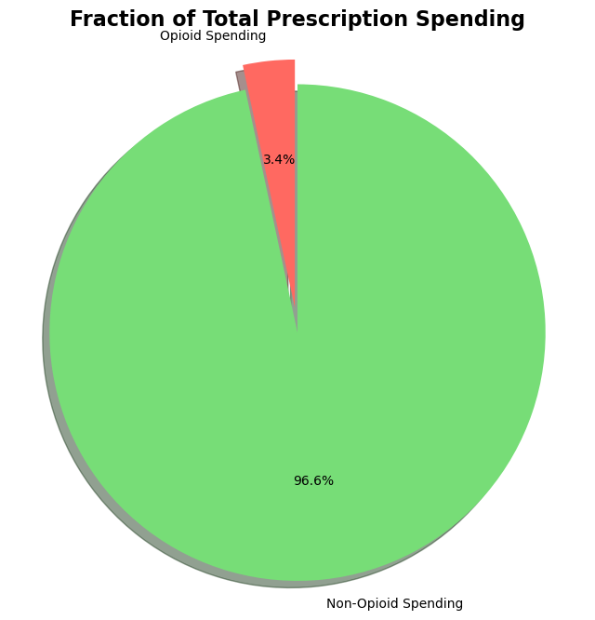

Slide 11
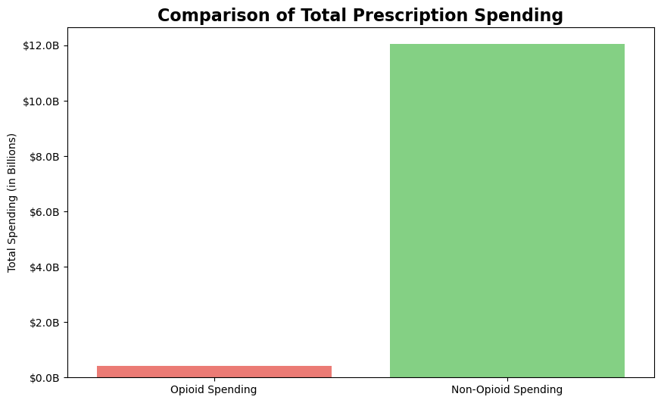

Slide 12
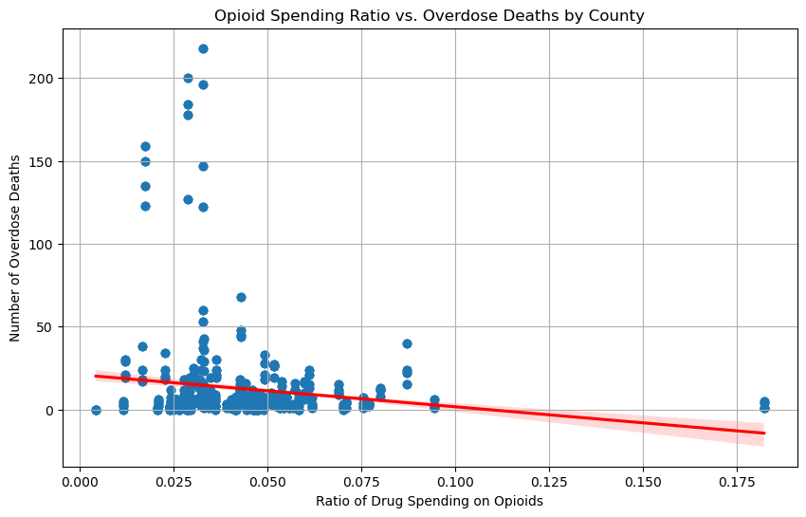

Slide 13
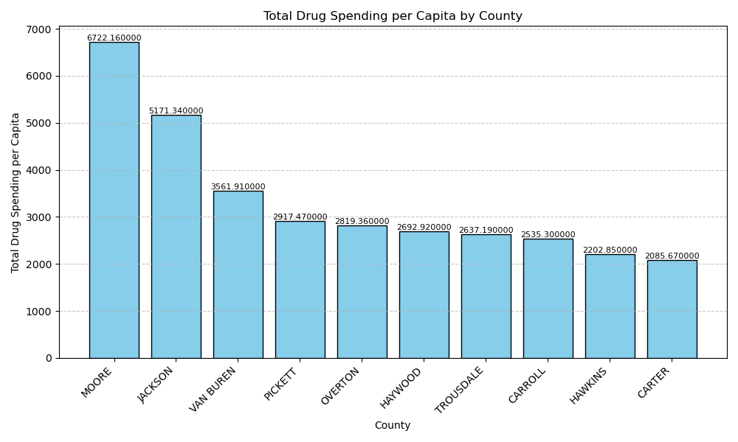

Slide 14
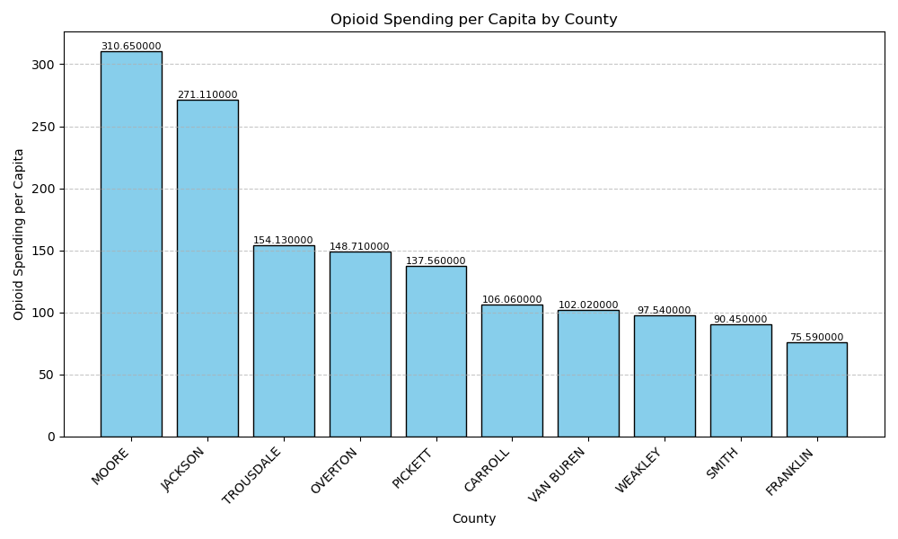

Slide 15
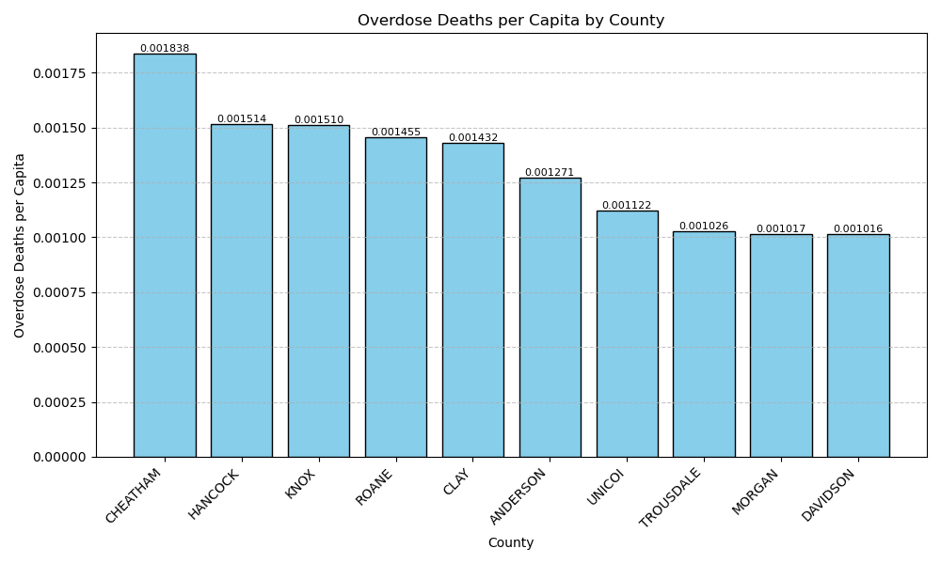

Slide 16

Does the Unemployment Rate Affect Overdose Deaths and Spending on Opioids?

Slide 17
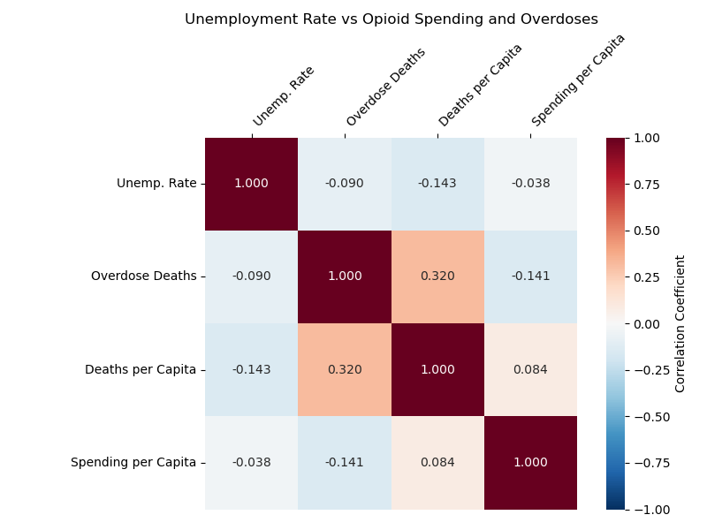

Slide 18
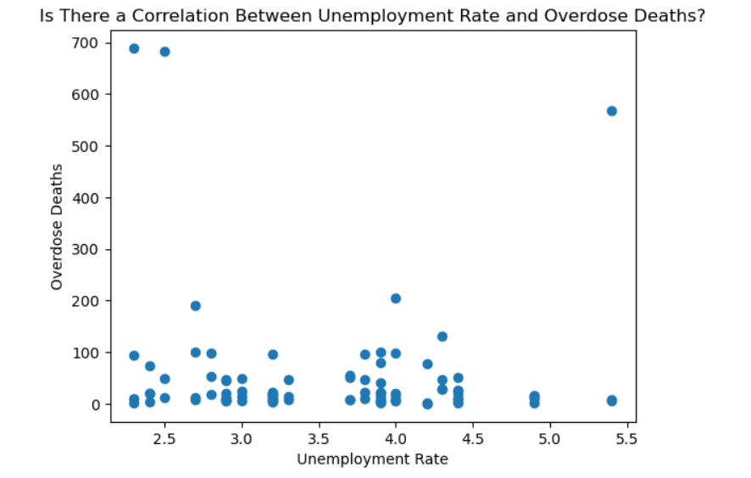

Slide 19
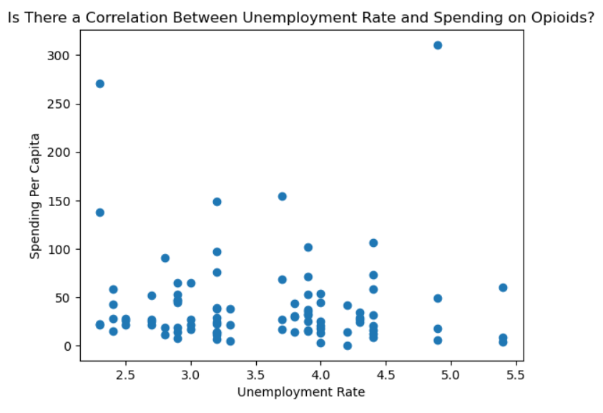

Slide 20
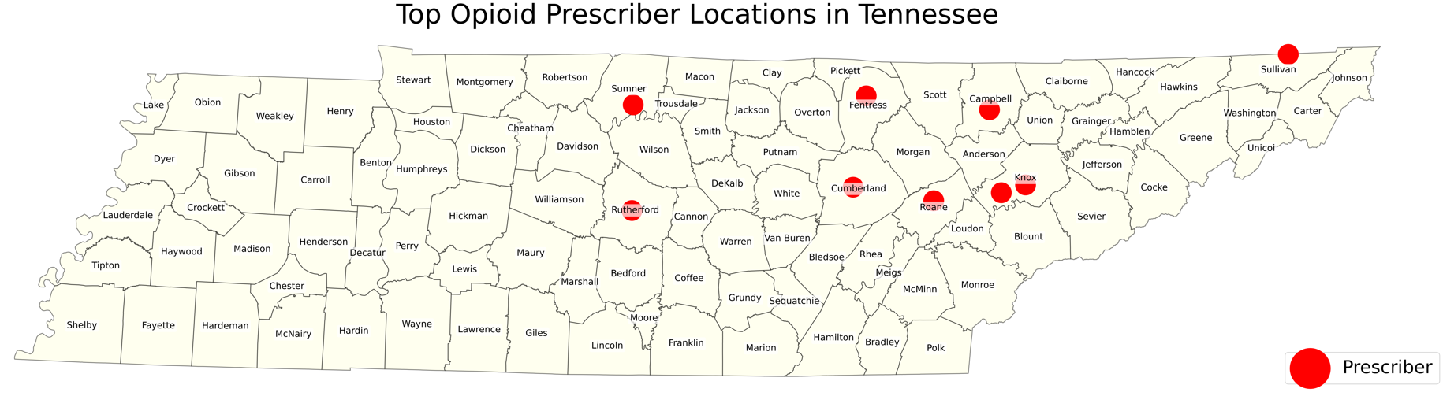
Top prescriber locations are in central TN and eastward
Davidson and Shelby counties are not included
Counties surrounding Davidson contain top prescribers
Majority in less populated or rural areas
Knoxville and Bristol suggest that it is not necessarily a rural trend
NE Tennessee should be identified as an area of interest

Slide 21
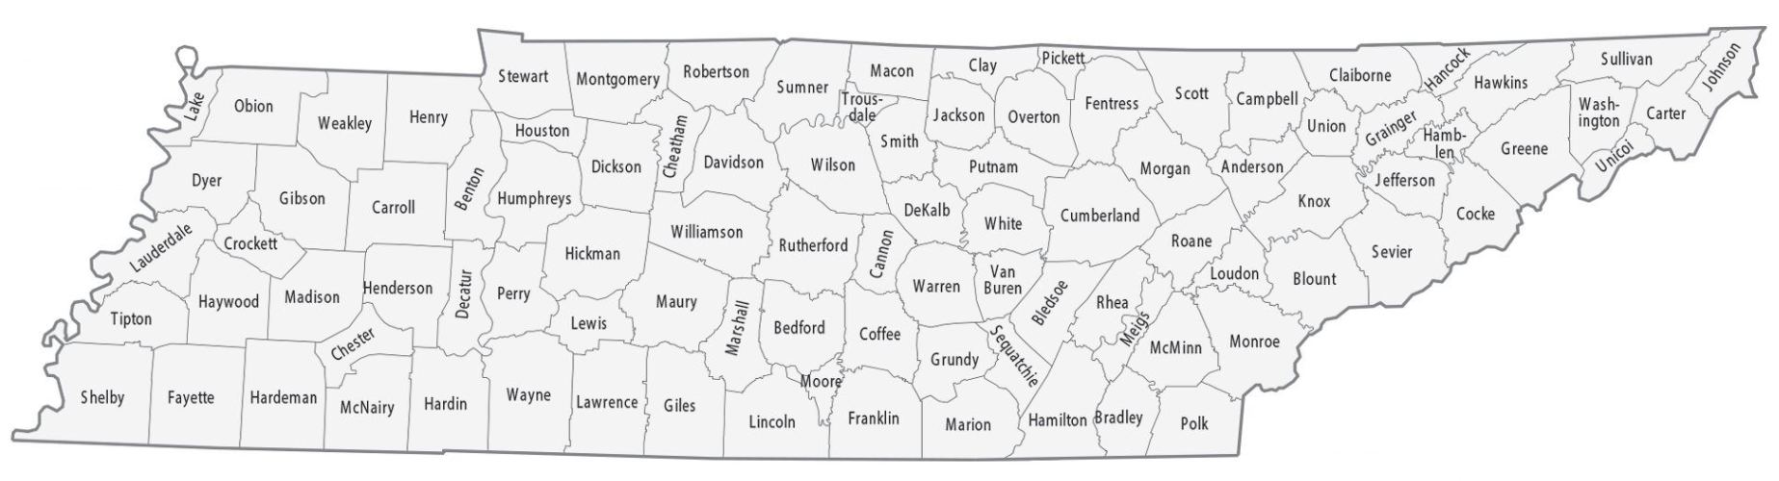
Prescriber Identifier by County Tool
Active opioid prescribers in every county
The further east you travel in TN, the higher the average prescription rate
The counties between Nashville and Memphis contain the lowest prescription rates
Perry, Decatur, Henderson, Madison counties

Slide 22
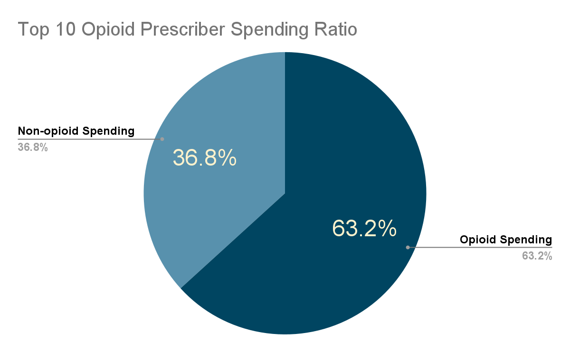
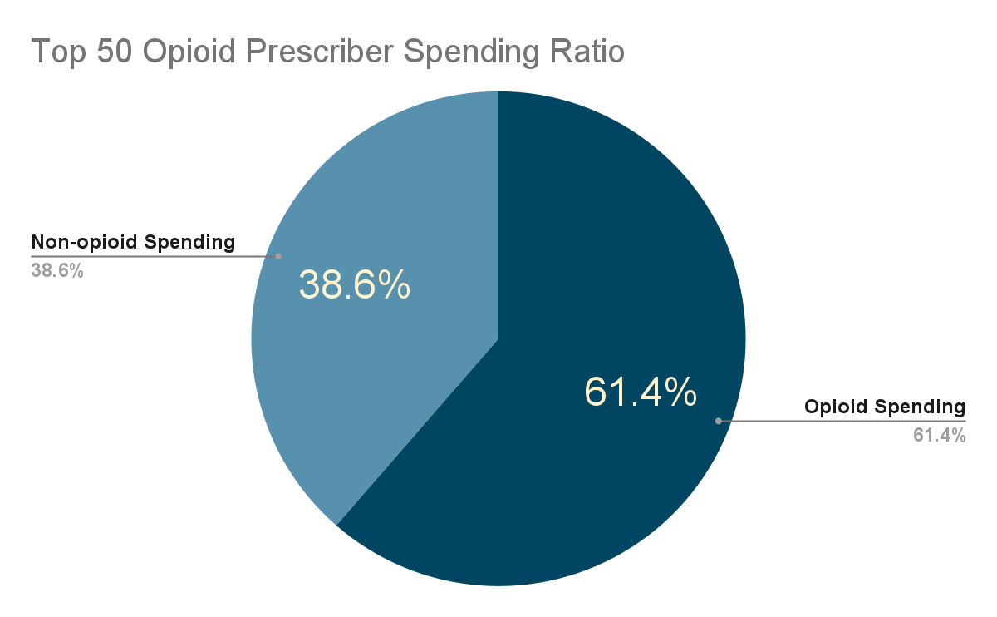
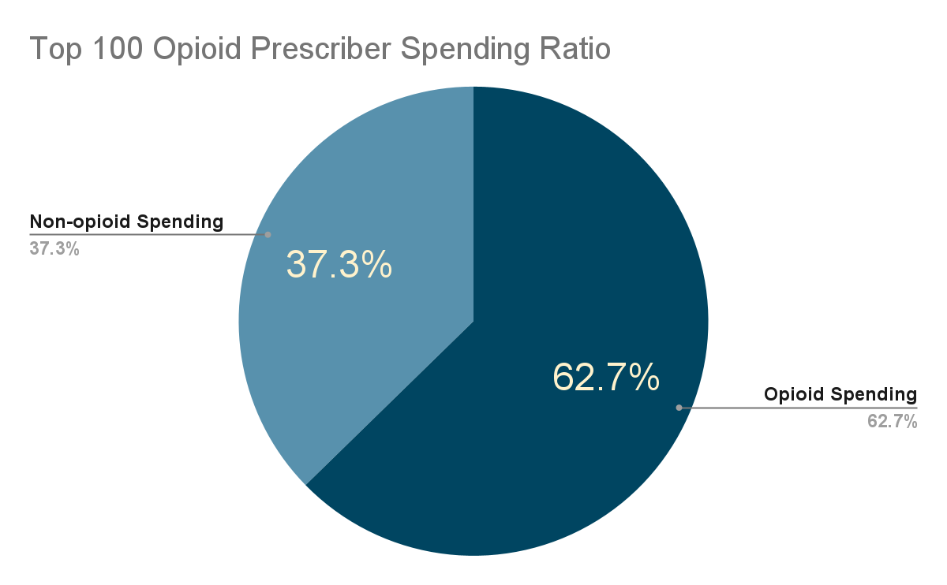
Nearly ⅔ of drugs prescribed by the top prescribers are opioids
This trend remains virtually the same for the top 50 and top 100
This shows a very consistent tendency for prescribers
Those who prescribe opioids at a higher rate are likely to continue prescribing

Slide 23
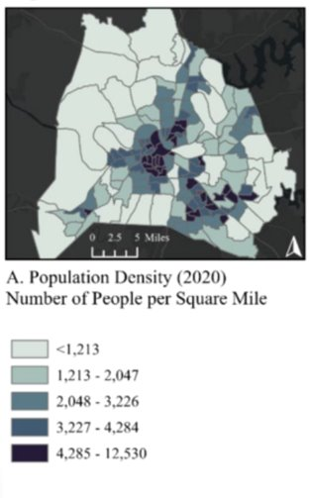
Map of Opioid Prescriptions in the Nashville Area
As of 2018, overdose deaths were trending upwards
The most opioids prescribed are in central Nashville
Population density plays a role
SE Nashville has a large volume of opioid prescriptions
ZIP code 37205 also has a large volume
Does economic status play a role?
Missed Trash Collection Pickups, Nashville

Slide 24
Summary
Population plays a large role in opioid prescription rates and deaths, but it’s not the determining factor
Rural areas may have similar overdose rates to metropolitan areas
There is a precedent of reduced opioid deaths in major cities
Memphis, Shelby County TN. Deaths are trending downward
Notes:
"While population influences opioid prescription and death rates, it is not the determining factor. Rural areas can face overdose rates similar to metropolitan regions, yet major cities like Memphis and Shelby County show a precedent for progress, with deaths now trending downward."

Slide 25
Conclusion
More oversight of opioid prescriptions in Tennessee is essential to reducing overdose death rates
Top opioid prescribers can be identified, and steps taken to reduce prescription rates
The rural counties of TN should be scrutinized more closely for prescription abuse
Notes:
"Tennessee cannot afford to ignore the role of prescription oversight in the opioid crisis—without stronger accountability for prescribers and closer monitoring in rural counties, overdose deaths will continue to rise."

